Slide 1
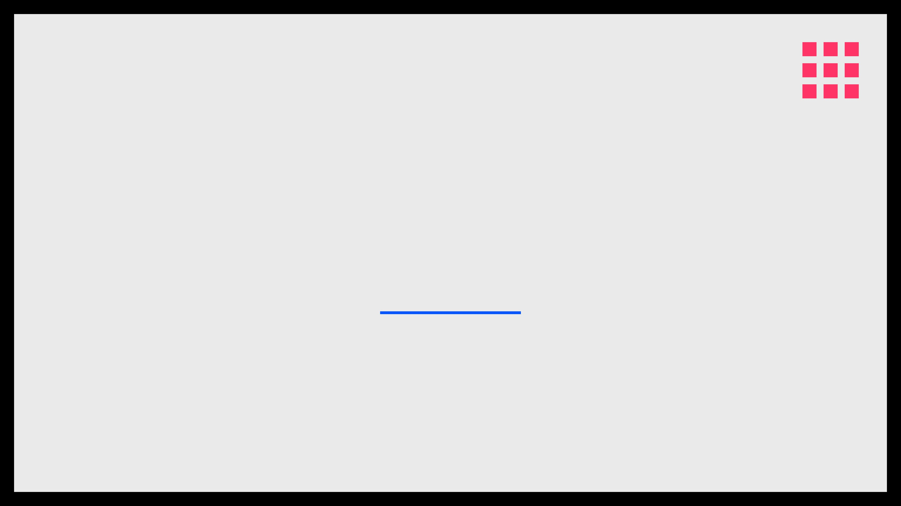
XLNET
GENERALIZED AUTOREGRESSIVE PRETRAINING
CONTEXTUAL EMBEDDINGS
|
ADVANCED NLP ARCHITECTURE
PRESENTERS: TOUSEEF AHMED NUM-BSCS-2022-18 REHAN MAHMOOD FAROOQI NUM-BSCS-2022-49

Slide 2

THE EVOLUTION OF CONTEXTUAL EMBEDDINGS
STATIC ERA
RNN ERA
TRANSFORMER ERA
THE XLNET ROLE
Word2Vec & GloVe
ELMo
Hybrid Pretraining
Fixed vectors for words
Embeddings from Language
BERT
Combines Autoregressive and
regardless of context.
Models.
Bidirectional Encoder
Autoencoding models.
Limitation
Innovation
Representations.
Goal
Cannot handle polysemy (e.g.,
Bidirectional LSTM captures
Innovation
Overcome BERT's masking
"bank").
left and right context.
Deep bidirectionality via
limitations.
Masked LM.
THE NEXT LEAP

Slide 3

BERT'S ACHILLES' HEEL: THE MASKING PROBLEM
PROBLEM 1: INDEPENDENCE
PROBLEM 2: DISCREPANCY
INDEPENDENCE ASSUMPTION
PRETRAIN-FINETUNE GAP
BERT assumes masked tokens are independent of each other. It predicts each [MASK] separately, failing to capture dependencies between them.
The [MASK] token used during training never appears during real-world inference. This artificial noise limits performance on downstream tasks.
Loss of contextual nuances between masked words.
Inconsistent input between training and usage.

Slide 4

THE XLNET BREAKTHROUGH: HYBRID PRETRAINING
AUTOREGRESSIVE (AR)
AUTOENCODING (AE)
GENERALIZED AR
THE GPT WAY
THE BERT WAY
THE XLNET WAY
Predicts the next token based on a fixed direction (left-to-right). Excellent for generation but lacks bidirectional context.
Reconstructs input from corrupted versions using [MASK]. Captures bidirectional context but introduces artificial noise and independence assumptions.
Uses an AR objective on permutations of the input sequence. Captures bidirectional context naturally without masking.
BEST OF BOTH WORLDS

Slide 5

PERMUTATION LANGUAGE MODELING (PLM)
THE CORE CONCEPT
BIDIRECTIONAL CAPTURE
NO MASKING REQUIRED
Instead of a fixed left-to-right order, XLNet trains on all possible permutations of a sequence. This allows the model to predict a token using context from any other position.
By shuffling the order, a token can "see" tokens that originally appeared both before and after it. This achieves deep bidirectionality without the need for artificial masking.
Since the prediction order is permuted, the model naturally learns dependencies without needing [MASK] tokens, eliminating the pretrain-finetune discrepancy.
SHUFFLED ORDERING
NATURAL CONTEXT
ZERO NOISE

Slide 6

THE XLNET EMBEDDING PROCESS: STEP-BY-STEP
01
02
03
04
TOKENIZATION
POSITIONING
ATTENTION
OUTPUT
Sentences are broken into subwords using SentencePiece. Unlike BERT, no [MASK] tokens are added to the input sequence.
Relative Positional Encoding is applied. This allows XLNet to understand where tokens are relative to each other across long sequences.
The Two-Stream Mechanism processes the tokens. Content and Query streams ensure context is learned without "cheating."
The final hidden state for each token is a dense vector representing its meaning within the specific context of the sentence.
SUBWORD ENCODING
DISTANCE-AWARE
PLM MECHANISM
DYNAMIC EMBEDDING

Slide 7

A SIMPLE MATHEMATICAL EXAMPLE
THE SETUP
THE PREDICTION MATH
Sentence: "The cat sat" Tokens: x₁="The", x₂="cat", x₃="sat"
P(x₂ | x₃, x₁, z₂)
z₂ represents the target position (index 2).
A RANDOM PERMUTATION
The model uses the Query Stream (g₂) to calculate the probability:
Order: [3, 1, 2] Goal: Predict x₂ ("cat") at position 2.
g₂ = Attention(Query=z₂, Key={x₃, x₁}, Value={x₃, x₁})
In this order, the model sees x₃ and x₁ before predicting x₂.
By only using the position z₂ (not the content "cat"), XLNet learns to predict "cat" using context from "sat" and "The".

Slide 8

VISUALIZING PLM: HOW SHUFFLING CAPTURES CONTEXT
ORIGINAL ORDER
1
2
3
4
Natural sequence of tokens in the sentence.
PERMUTATION A
3
2
4
1
Order: [3, 2, 4, 1] Predicting 4 using 3 and 2.
PERMUTATION B
2
4
3
1
Order: [2, 4, 3, 1] Predicting 4 using only 2.
VISIBLE CONTEXT
TARGET TOKEN
FUTURE (HIDDEN)

Slide 9

TWO-STREAM SELF-ATTENTION
SOLVING THE PREDICTION PARADOX: KNOWING "WHERE" WITHOUT SEEING "WHAT"
h
g
_{i}
_{i}
CONTENT STREAM
QUERY STREAM
The standard Transformer attention. It encodes both the positional information and the actual content of the token.
A specialized stream that only has access to the target position and the context of other words, but not the target word's content.
USED AS CONTEXT FOR OTHERS
PREVENTS "CHEATING"
FULL SEMANTIC REPRESENTATION
POSITION-AWARE PREDICTION
VISIBLE TO ALL SUBSEQUENT TOKENS
ESSENTIAL FOR AR OBJECTIVE
REPRESENTS THE "KNOWLEDGE"
ENABLES THE "PREDICTION"

Slide 10
LEVERAGING TRANSFORMER-XL: LONG-RANGE DEPENDENCIES
SEGMENT RECURRENCE
RELATIVE POSITIONAL ENCODING
BEYOND FIXED WINDOWS
XLNet reuses hidden states from previous segments to provide context for the current one. This creates a "memory" that flows across the document.
DISTANCE-BASED CONTEXT
Instead of absolute positions, it learns the relative distance between tokens. This is crucial for maintaining coherence when segments are reused.
Enables modeling of dependencies that span thousands of tokens.
NO 512-TOKEN LIMIT
THE RESULT
Superior performance on long-form text tasks like document summarization and long-passage question answering.

Slide 11

XLNET VS. BERT: A HEAD-TO-HEAD COMPARISON
FEATURE
BERT
XLNET
OBJECTIVE
Autoencoding (Denoising)
Permutation Autoregressive
CONTEXT
Bidirectional (via Masking)
Bidirectional (via Permutation)
INPUT NOISE
HIGH
NONE
Artificial [MASK] tokens
Natural Text Only
LONG CONTEXT
Limited (Fixed 512 segments)
Excellent (Transformer-XL)
DEPENDENCIES
Independence Assumption
Full Dependency Modeling

Slide 12

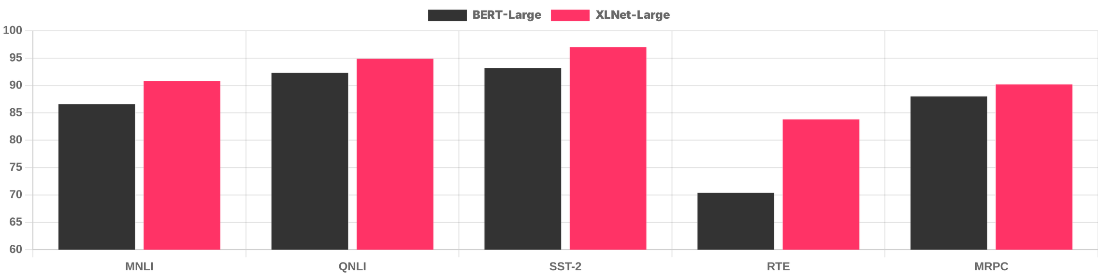
STATE-OF-THE-ART PERFORMANCE: BENCHMARK RESULTS
GLUE BENCHMARK COMPARISON
SQUAD 2.0
XLNet leads BERT by over 7 F1 points in reading comprehension.
20+ TASKS
XLNet outperforms BERT across 20+ NLP tasks, showing robust permutation modeling.
DATA SOURCE: YANG ET AL. (2019) "XLNET: GENERALIZED AUTOREGRESSIVE PRETRAINING"

Slide 13

REAL-WORLD APPLICATIONS OF XLNET
COMPLEX QUESTION ANSWERING
NUANCED SENTIMENT ANALYSIS
Ideal for systems that need to "read" and synthesize information from long passages or multiple documents to find precise answers.
Captures subtle emotional shifts in long reviews or social media threads where context from the beginning affects the end.
TRANSFORMER-XL MEMORY
BIDIRECTIONAL CONTEXT
LEGAL & MEDICAL CLASSIFICATION
NEXT-GEN SEARCH ENGINES
Organizing large-scale professional documents where long-range dependencies and technical terminology are vital.
Improving result relevance by better understanding the intent behind long, conversational user queries.
LONG-RANGE DEPENDENCY
ZERO MASKING NOISE

Slide 14

CONCLUSION: THE FUTURE OF CONTEXTUAL EMBEDDINGS
SUMMARY
LEGACY
FINAL TAKEAWAY
XLNet proved that masking is not required for bidirectionality. By using Permutation Language Modeling, it captures natural context without artificial noise.
It paved the way for modern architectures like T5 and GPT-3 by refining how we model long-range dependencies and language interconnectedness.
Permutation modeling remains a powerful tool for capturing the true interconnectedness of human language, moving us closer to human-like understanding.
NATURAL BIDIRECTIONALITY
ARCHITECTURAL FOUNDATION
THE POWER OF CONTEXT

